Slide 1
RESEARCH PROJECT PROPOSAL
CLAIM
TruthLens 499B
▼
Evidence-Grounded Multimodal Misinformation Verification for Bangla Social-Media Content
EVIDENCE
▼
VERDICT
Team presentation · Proposed work, not yet implemented

Slide 2
00 · LITERATURE REVIEW
1. BD-FakeDetect
Paper: A Multimodal Framework for Misinformation Detection in Bengali Using Large Language Models
https://ieeexplore.ieee.org/document/11502571
What did they do?
They created BD-FakeDetect, a manually curated Bengali misinformation dataset with 5,929 news articles/posts from verified fact-checking platforms. They used GPT-4o for multimodal misinformation detection and added a RAG pipeline to provide external evidence and reduce hallucination. Their final GPT-4o system achieved 81.8% validation accuracy.
Main method: Bengali text/image → GPT-4o → RAG evidence → misinformation classification
Gap / Limitation
The main task is still misinformation detection/classification. It does not establish the same complete claim-level workflow we are targeting: atomic claim → external evidence → evidence ranking/provenance → 3-way verification → evidence-grounded explanation → leakage-resistant evaluation.
So, Bangla + multimodal + RAG already exists. We cannot claim that as our novelty.
Our lesson: BD-FakeDetect is a very important baseline/dataset, but our work needs to go beyond simply asking:
“Is this post fake?”

Slide 3
00 · LITERATURE REVIEW
2. MultiBanFakeDetect
Paper: MultiBanFakeDetect: Integrating Advanced Fusion Techniques for Multimodal Detection of Bangla Fake News in Under-Resourced Contexts: https://www.sciencedirect.com/science/article/pii/S2667096825000291
What did they do?
They created 9,600 Bangla text-image pairs.
They tested:mBERT, XLM-R, DistilBERT, DenseNet-169, Early Fusion, Intermediate Fusion, Late Fusion
Their best multimodal model, DenseNet-169 + mBERT, achieved 79.69% accuracy, compared with 73.13% for text-only mBERT.
Main method: Bangla text + image → text/image encoders → fusion → Fake/Real
Gap
The authors themselves point out that the work:
focuses on static text + image, does not include audio/video, has limited interpretability, does not perform broader real-time/network-level analysis, has limitations in generalization across Bangla dialects and evolving misinformation.More importantly for our project, it is primarily classification, not external claim verification.
Our lesson
Multimodal Bangla detection is already done.
“We use XLM-R + ViT to detect Bangla fake news” ≠ strong novelty.

Slide 4
00 · LITERATURE REVIEW
3. BTMD / MoME-BanglaFake
Dataset: Bengali Trimodal Misinformation Dataset (BTMD) https://huggingface.co/datasets/Faysal1000/BTMD
What did they do?
BTMD contains 6,058 Bengali news instances across: Text, Image, Video
It supports: Real vs Fake, Real / Misinformation / Satire / Clickbait
There are 4,457 text, 4,289 image and 1,383 video instances.The associated MoME-BanglaFake framework uses a mixture-of-modality-experts idea for multimodal fake-news detection.
Main method: Text + Image + Video → modality experts → fusion/decision → Fake/Real
Gap
The major limitation for us is that the task remains mainly: multimodal misinformation classification
does not give us the full: claim → web evidence → evidence quality → provenance → verification → explanation Also, the dataset/model page currently labels the MoME-BanglaFake paper as under review, so we should not present it as an established published-paper result.
Our lesson
This paper/dataset makes the Bangla + text + image + video part much less novel.
Therefore, our research should move toward evidence-grounded verification, not simply trimodal classification.

Slide 5
00 · LITERATURE REVIEW
4. CAMRF
Paper: Context-aware multimodal reasoning for explainable Bengali fake news detection using vision-language models
https://link.springer.com/article/10.1007/s44354-026-00047-w
What did they do?
They developed CAMRF for Bengali fake-news detection.
Pipeline:Image → EasyOCR, Image → ResNet-50, Image → ViT
Then: OCR + ResNet + ViT → Context-Aware Multimodal Fusion → Qwen2-VL-2B → explanation + Real/Fake
They tested it on a 1,003-instance Bengali multimodal dataset and reported 97% accuracy.
Main method: OCR + CNN + ViT + VLM reasoning
Gap
Dataset only 1,003 samples; only binary Real/Fake; OCR can struggle with stylized text; VLM has higher computational cost; explanation quality was not quantitatively evaluated against gold explanations; future work includes audio/video; future work includes integrating fact-checking knowledge bases.
Our lesson: This is VERY important. They already have: Bangla + OCR + image + multimodal reasoning + explanation.
So, our innovation should not be: “We use multimodal reasoning and generate explanations.”
Instead, we can move the explanation toward: “This verdict is supported/refuted by these external sources.”
That is much stronger.

Slide 6
00 · LITERATURE REVIEW
Paper | Main contribution | Main limitation for us
BD-FakeDetect | Bangla + multimodal + GPT-4o + RAG | Mainly misinformation detection
MultiBanFakeDetect | Bangla text-image dataset + fusion | No video/evidence-grounded verification
BTMD/MoME | Bangla text-image-video | Mainly classification
CAMRF | Bangla + OCR + ViT + VLM + explanation | Binary; no external evidence verification
FEVER | Claim + evidence + 3-way verification | Wikipedia/textual; not Bangla/multimodal
MOCHEG | Multimodal evidence retrieval + verification + explanation | Not Bangla/Bangladesh-specific
AVeriTeC | Real-world claims + web evidence + evidence-quality evaluation | Mainly textual
EVID-Bench | Video + web search + evidence | Not Bangla; focused on video manipulation
FACTIFY3M | Large multimodal verification + explanation | Not Bangla/provenance-focused
VERITE | Robust multimodal benchmark; fights unimodal bias | No external evidence/provenance/video

Slide 7
01 · WHY THIS MATTERS
Problem & Motivation
1
2
3
Bangla misinformation spreads through text, images, and videos.
Existing systems often focus on Fake / Real classification.
Classification alone does not show whether the factual claim is supported by reliable evidence.
PREDICTION
→
VERIFICATION
TruthLens 499B · Research proposal (proposed work)
2

Slide 8
02 · FROM PREDICTION TO VERIFICATION
What Is the Core Idea?
TRADITIONAL APPROACH
Post
→
Fake / Real
TRUTHLENS
Post
→
CLAIM
→
EVIDENCE Retrieval
→
EVIDENCE Assessment
→
CROSS-MODAL Verification
→
Verdict + Explanation
“We do not simply ask whether a post looks fake. We ask what the post claims, what reliable evidence says, and whether the modalities and evidence are consistent.”
TruthLens 499B · Research proposal (proposed work)
3

Slide 9
03 · WHAT IS MISSING
Research Gap
1
Evidence quality
2
Cross-modal contradiction
Retrieved evidence may be relevant but not sufficient to justify a verdict.
Text, image, and video may describe different events, dates, places, or contexts.
3
Missing-modality robustness
4
Evaluation validity
Can external evidence compensate when image/video information is unavailable?
Random splits can inflate results through claim / event / media leakage.
Novelty is framed conservatively: Bangla-specific multimodal verification + evidence grounding + provenance + leakage-resistant evaluation.
TruthLens 499B · Research proposal (proposed work)
4

Slide 10
05 · PIPELINE
Proposed System Architecture
1 · Understand the post
2 · Find evidence
3 · Verify & explain
Bangla social-media content
Evidence search
Evidence verification
▼
▼
▼
Text / Video
▶
Fact-check + news + web sources
▶
Supported / Refuted / Insufficient
▼
▼
▼
Frames + Audio + OCR
Evidence ranking
Evidence-grounded explanation
▼
Claim extraction
▼
Claim checkworthiness
Final verdict labels: SUPPORTED · REFUTED · INSUFFICIENT
▼
Multimodal claim representation
TruthLens 499B · Research proposal (proposed work)
6

Slide 11
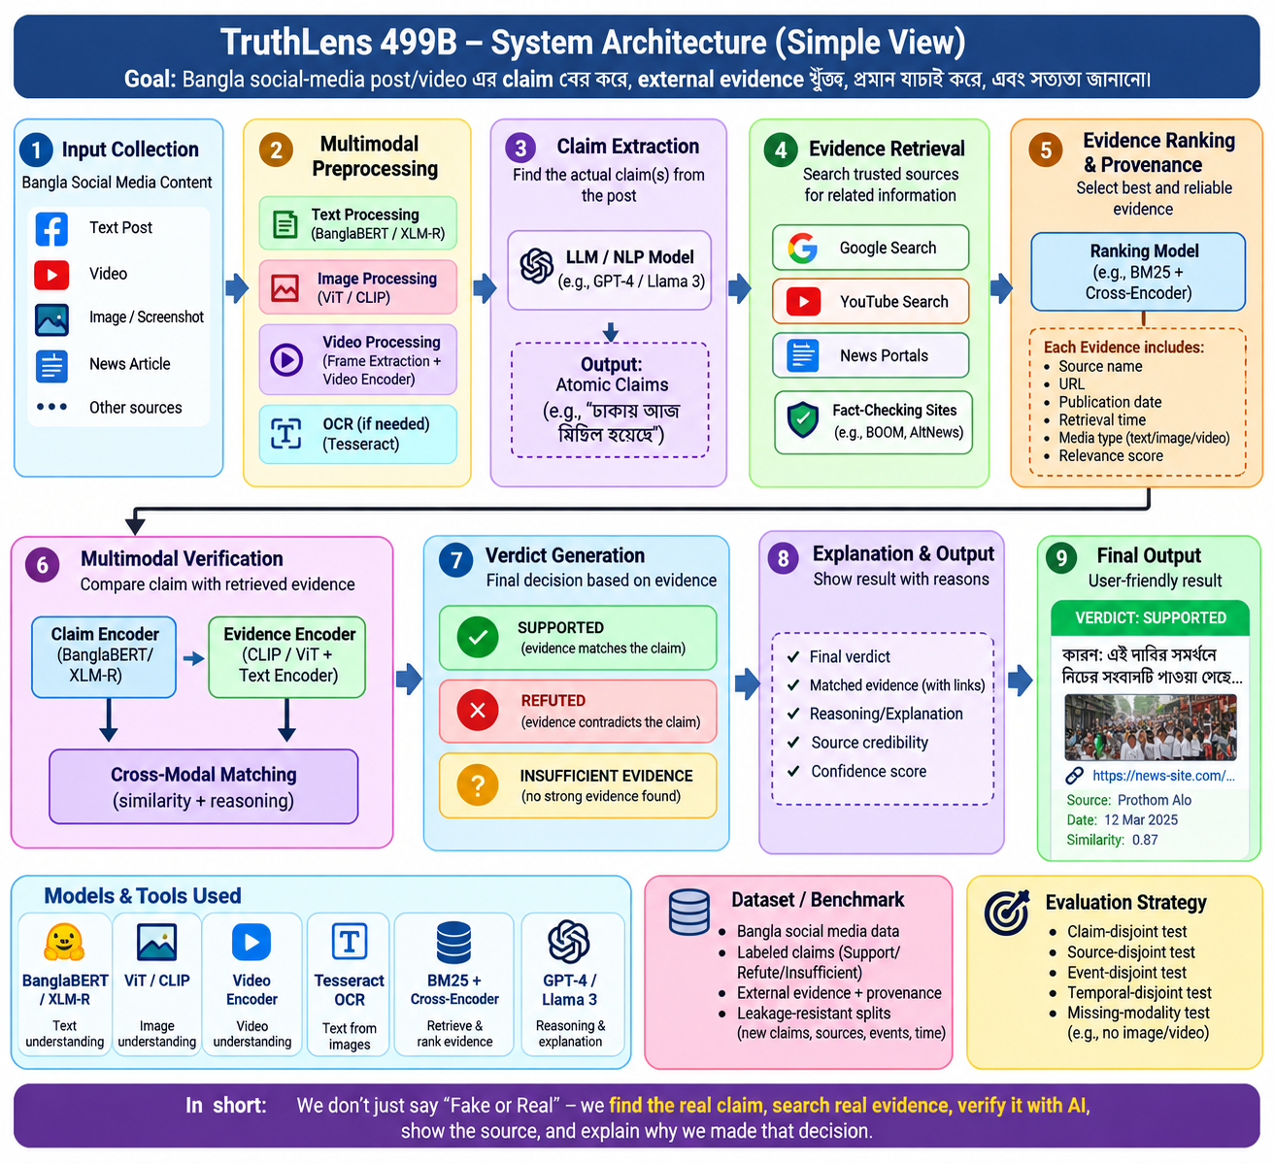

Slide 12
06 · CLAIM-CENTRIC, MULTIMODAL
Dataset Strategy
PILOT
≈100–150 samples
Fields per sample
Sample ID
Source URL
Platform
Date
Caption / text
Video
▼
Frames
Audio / transcript
OCR
SCALE (if the pipeline works)
≈1,000–1,500 high-quality samples
Claim
Checkworthiness
Evidence URL / text / rank
Human verdict
Rationale
Topic
Event ID
Split
HUMAN VERIFICATION determines final ground truth. LLM/AI output is assistance, not ground truth.
TruthLens 499B · Research proposal (proposed work)
7

Slide 13
11 · ROADMAP (PROPOSED)
Feasibility & Final Vision
1
2
3
4
5
6
Phase 1
Phase 2
Phase 3
Phase 4
Phase 5
Phase 6
Dataset schema + annotation guideline
100-sample pilot
Retrieval + annotation pipeline
Main dataset
Baselines + evidence experiments
Leakage-resistant evaluation + analysis
From Fake / Real Classification
→ Evidence-Grounded Verification
TruthLens 499B · Research proposal (proposed work)
12

